Slide 1

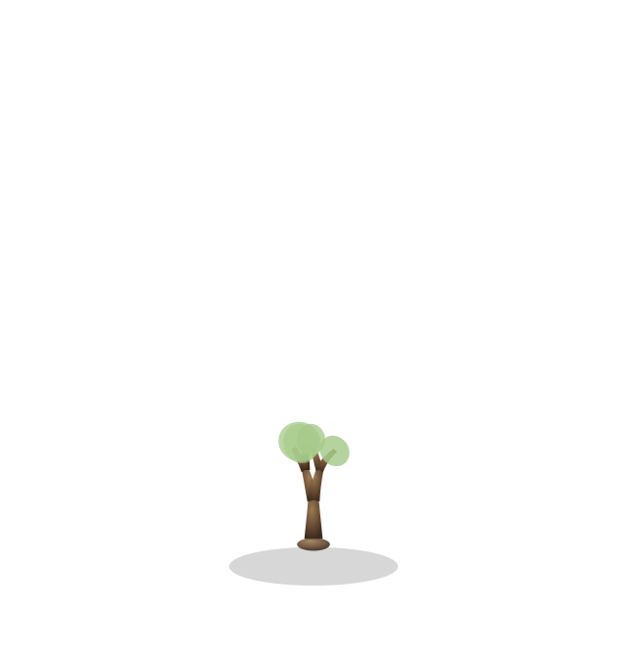
THE PROBLEM
Starting a new habit is difficult
Doing it alone makes it harder

Slide 2

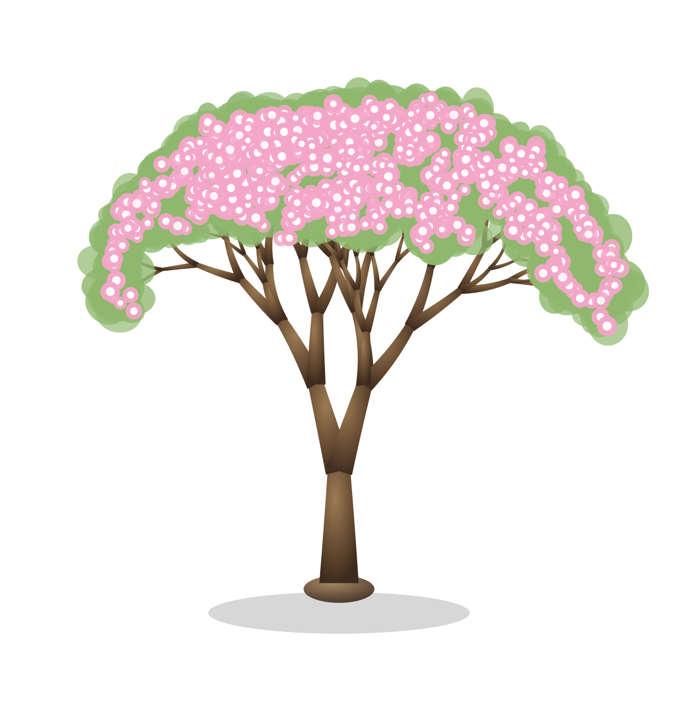
Grove
Grow together, one task at a time.

Slide 3

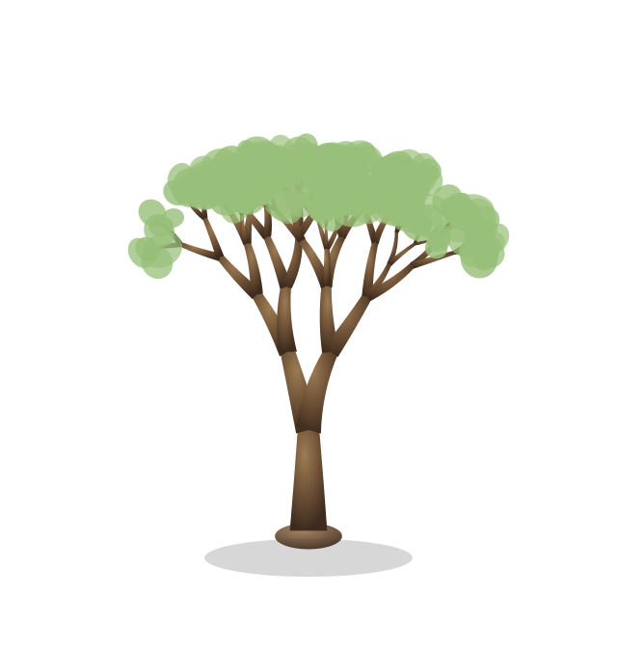
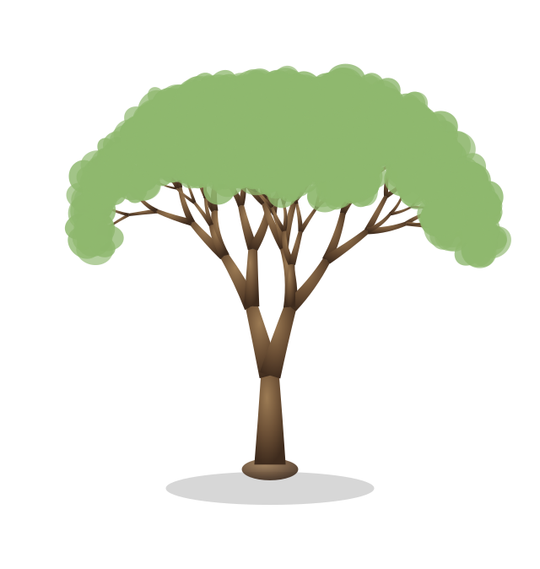
The Growth Tree
Complete daily tasks to grow your tree.
One level a day
The only way up is coming back.
Seeded per user No two trees match.
LEVEL 1
LEVEL 12
LEVEL 20

Slide 4

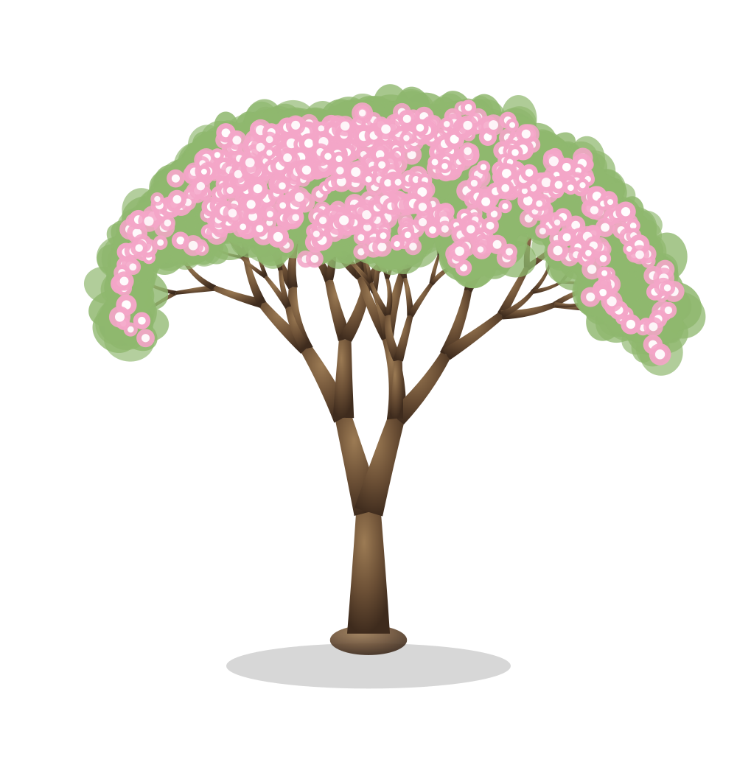
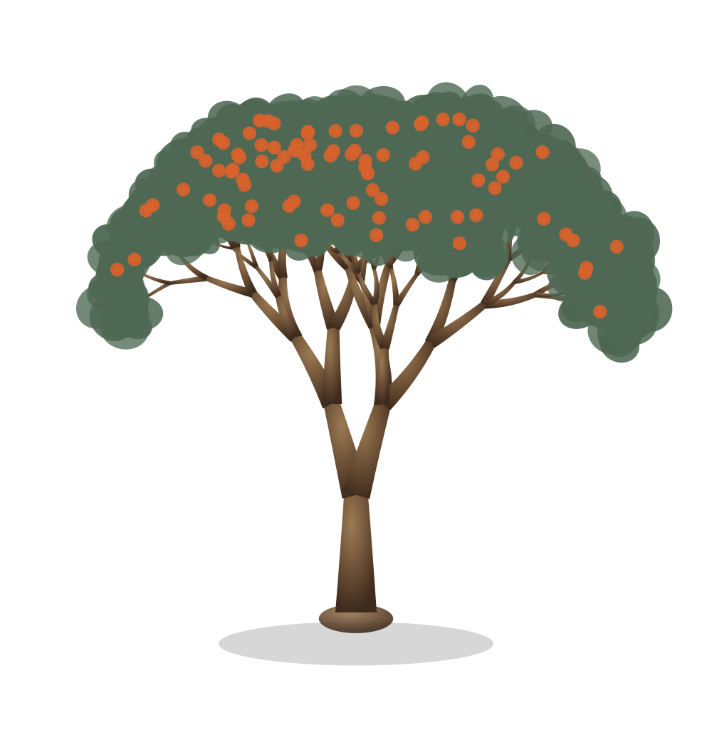
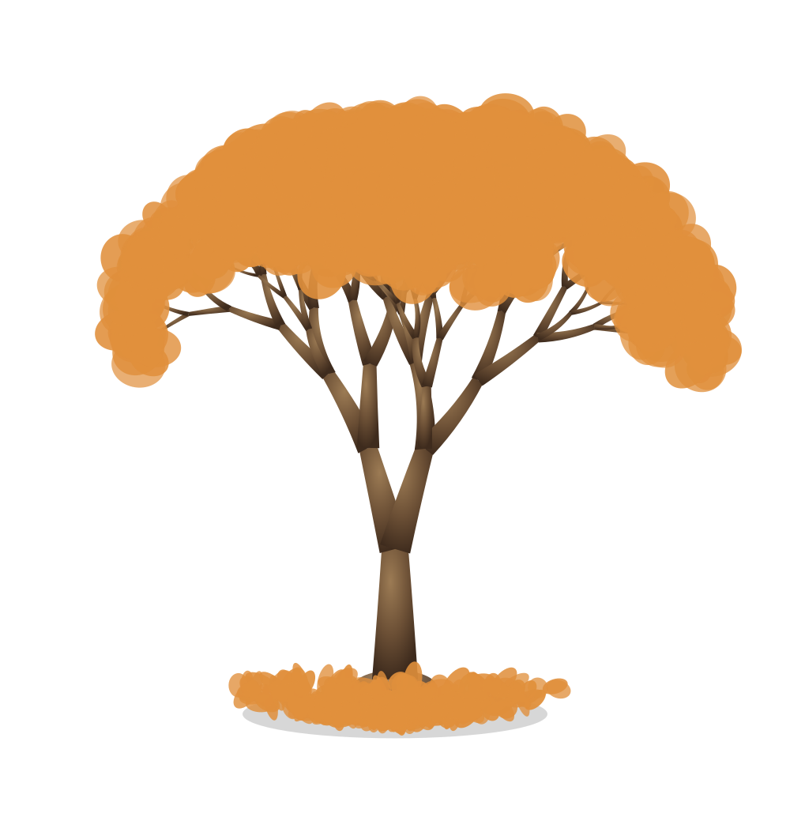
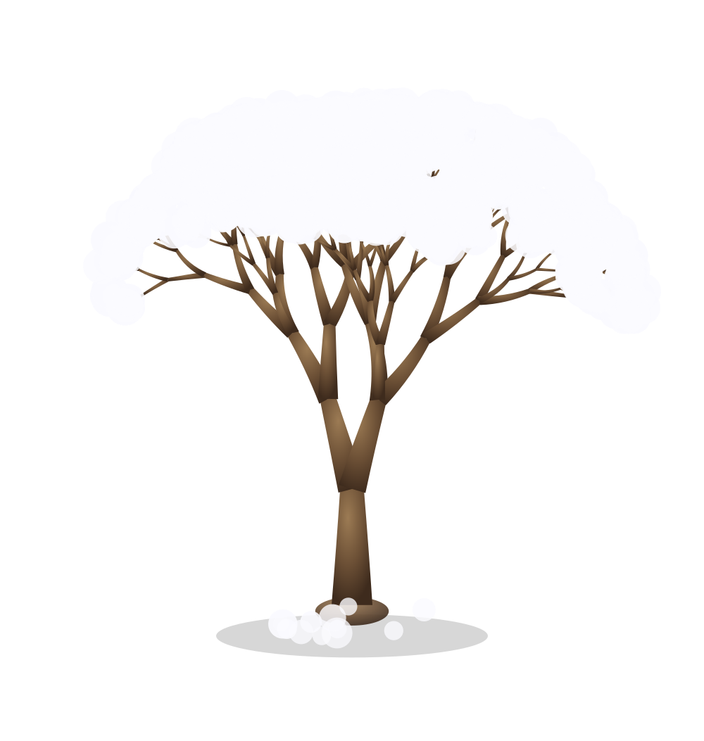
Then it starts living.
From level 21 the tree cycles through the seasons — changing a little every day.
Spring
Summer
Fall
Winter
LEVELS 21 – 40
LEVELS 41 – 60
LEVELS 61 – 80
LEVELS 81 – 100
buds open into blossom
deep green, and it fruits
leaves turn, then let go
Draped in winter snow

Slide 5

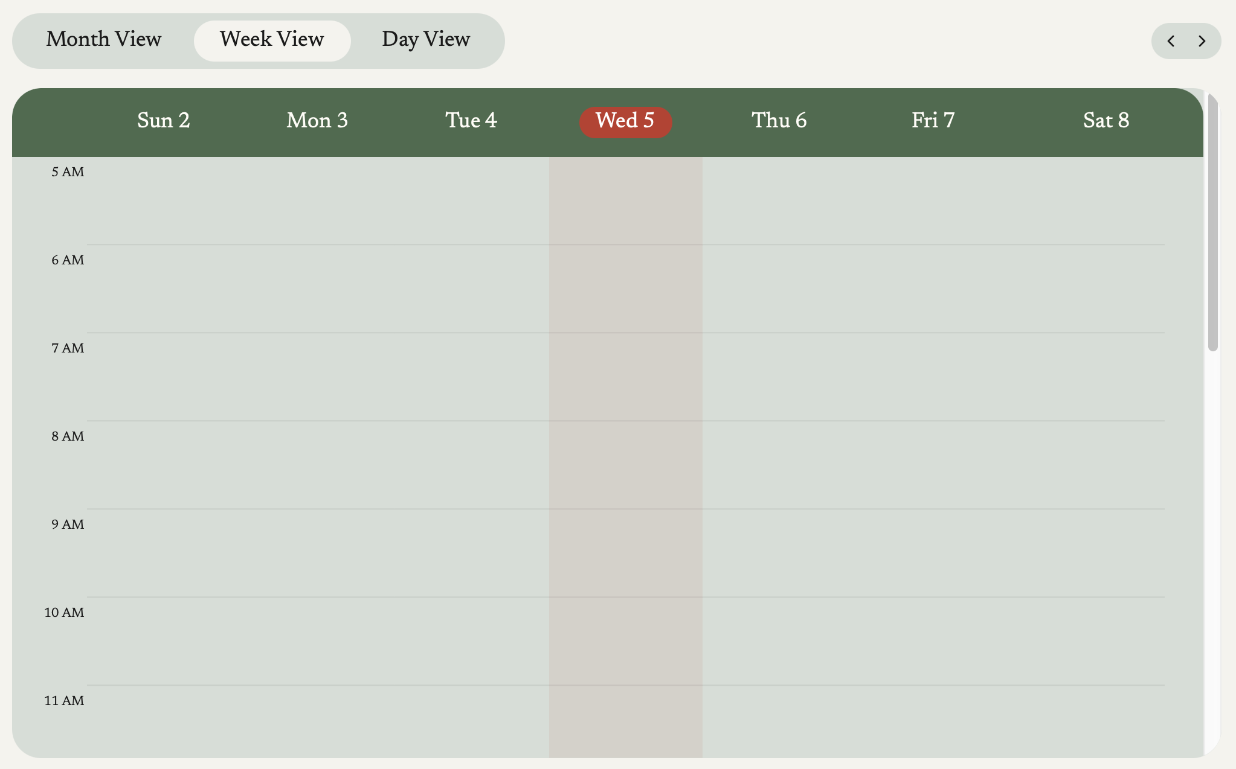
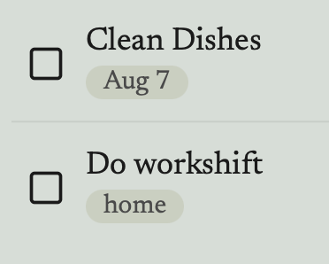
TASKS & CALENDAR
Rich task organization – tags and dates
Tasks have several organizational features, including Due Dates and Tags.In a future implementation, tasks could be organized in a calendar via their due dates.
Tags
For more granular organization
Due dates
Tasks can be assigned to a day

Slide 6

STUDY ROOMS
Humans are social animals!
The study rooms focus on having a secondary place to hang out with peers and friends to complete tasks.
Notes:
turner

Slide 7
INSIDE A ROOM
Features
Custom Rooms
Chat with peers!
Invite people!
Background Music
Study timer…
Interactive.
Notes:
turner

Slide 8
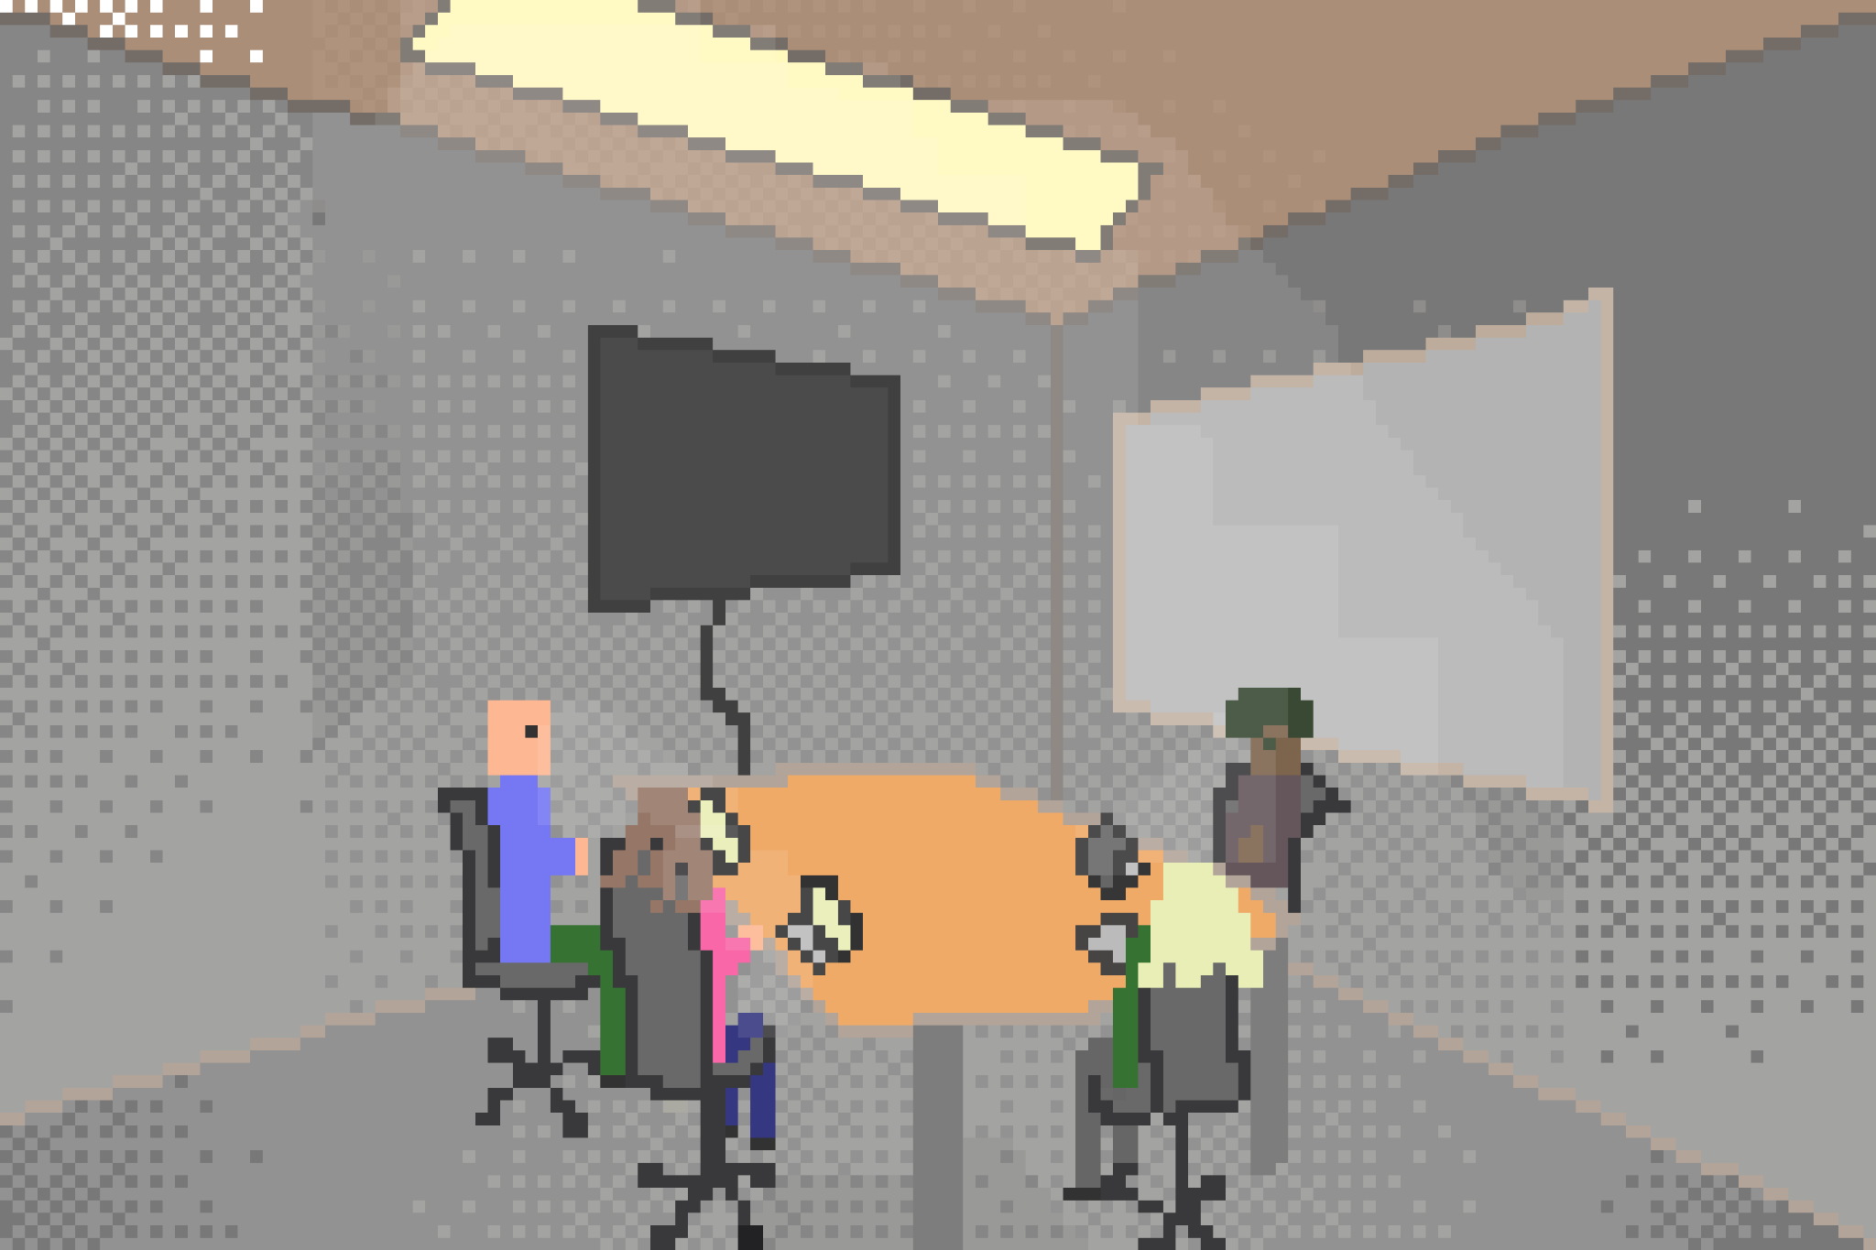
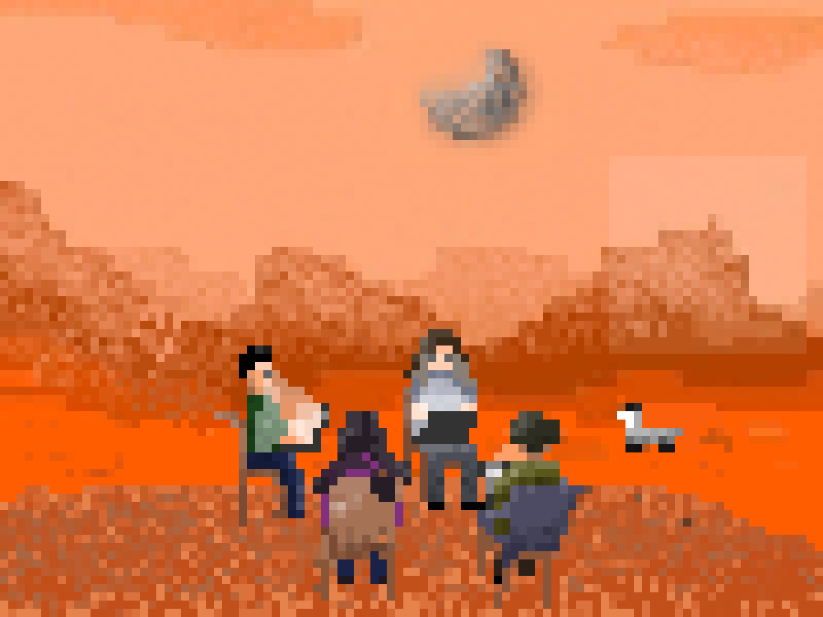
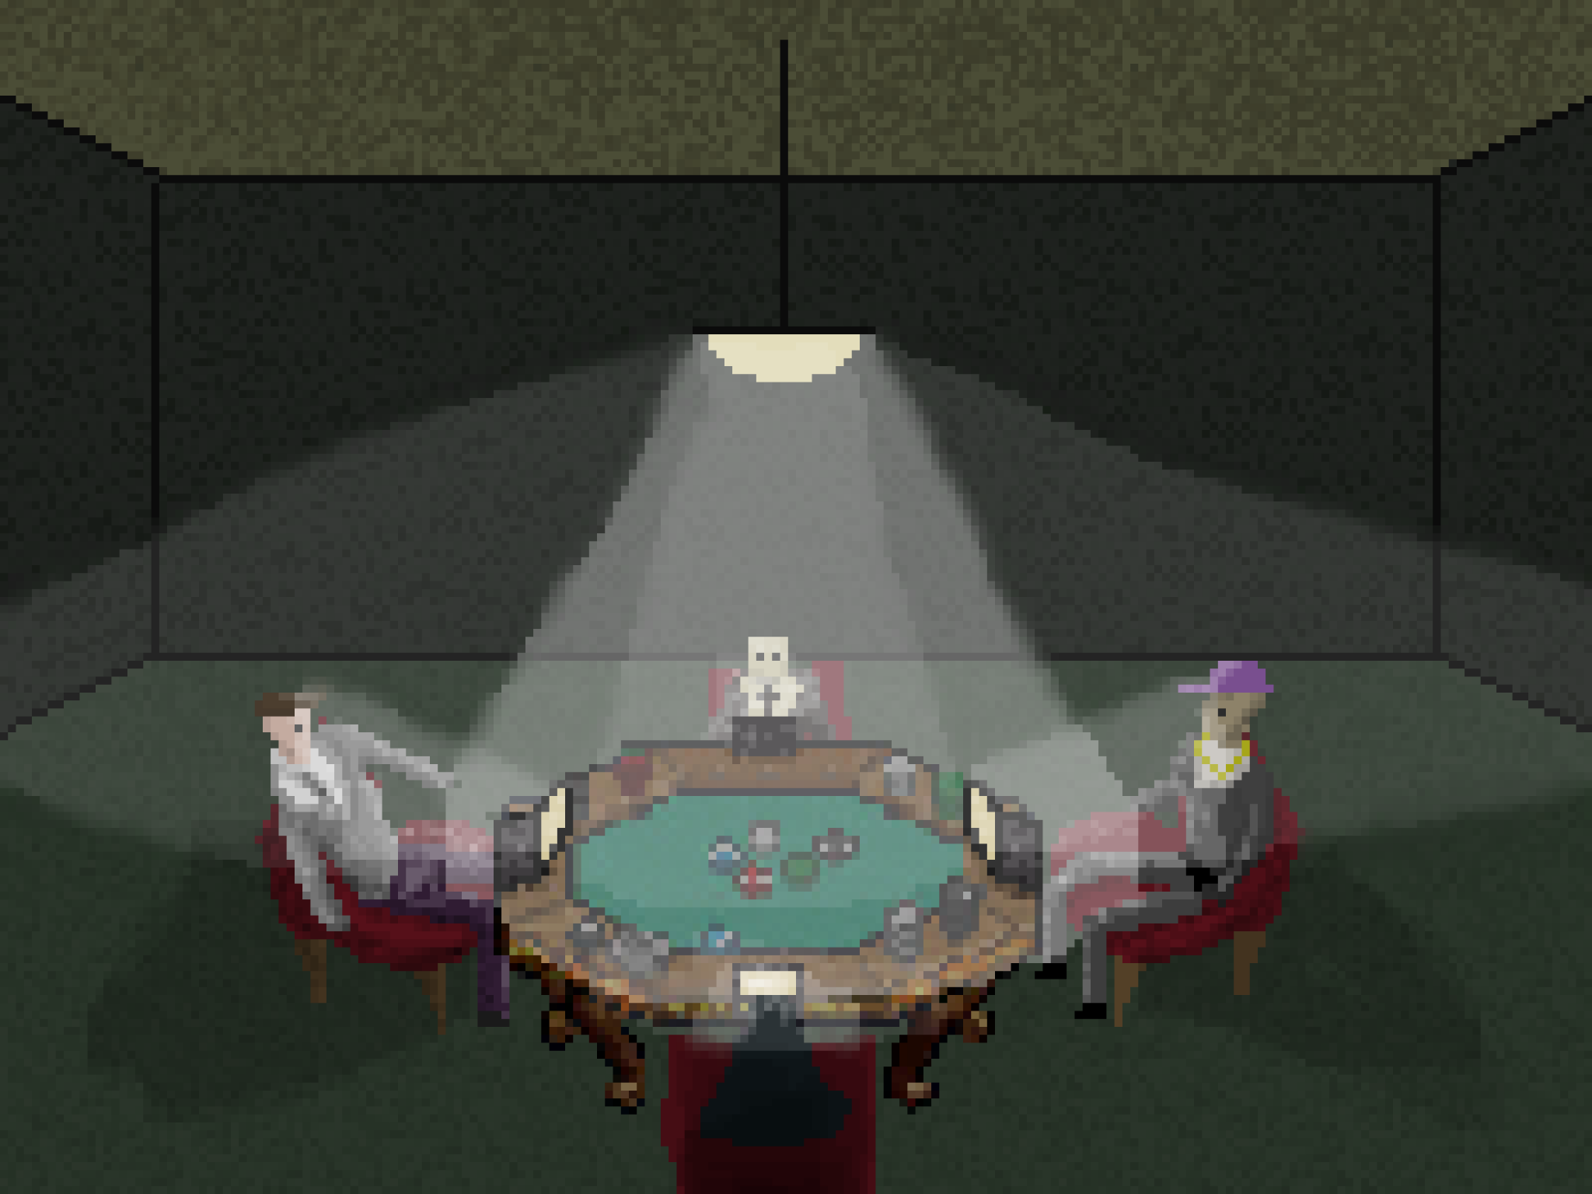
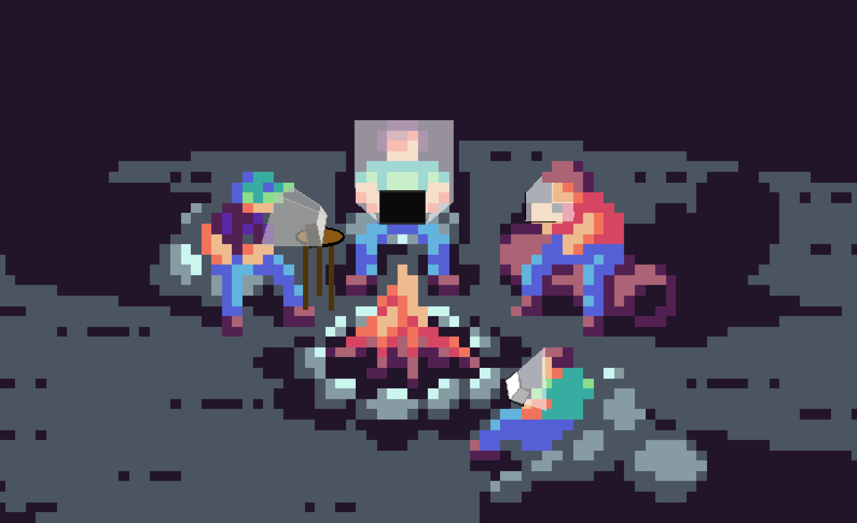
STUDY ROOMS
Notes:
turner

Slide 9

Live demo
01
02
03
Make it yours
Plan and finish
Study together
Log in, set your photo and bio, add a friend
Add homework #1, see it on the calendar, check it off
Open the lobby, create a room, invite your friend

Slide 10
WHAT WE LEARNED
We are not the only users…
Notes:
We are not the only users..

Slide 11

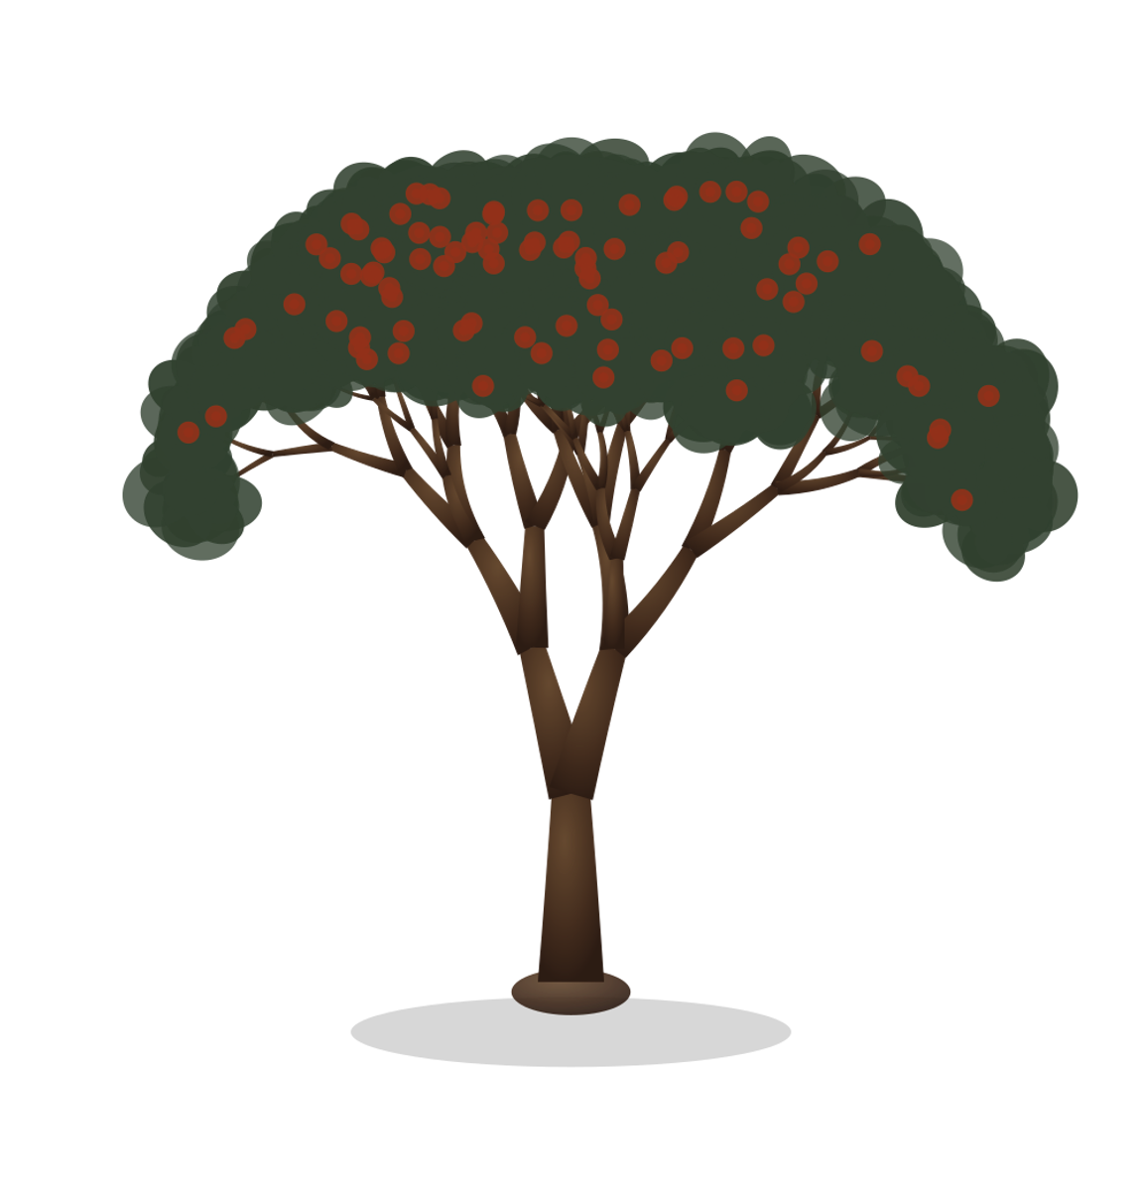
Grow together.
Questions?

